Slide 1
Aviation I.A.E.T
“Look deep into nature and then you will understand everything better” .
Albert Einstein

Slide 2
Who Are We ?
Eng/Ahmed Helmy Hamed: Aeronautical Engineer working at IAET as a laboratory engineer
Basem Hesham Ali : Student in Aeronautical engineering ,IAET
Mohamed Saeed Ragab : Student in Aeronautical engineering ,IAET .

Slide 3
Zero Gee Bee
Use a small scale autonomous drone vehicles for delivering goods and items . This is very important for the future large scale manned space flight.

Slide 4
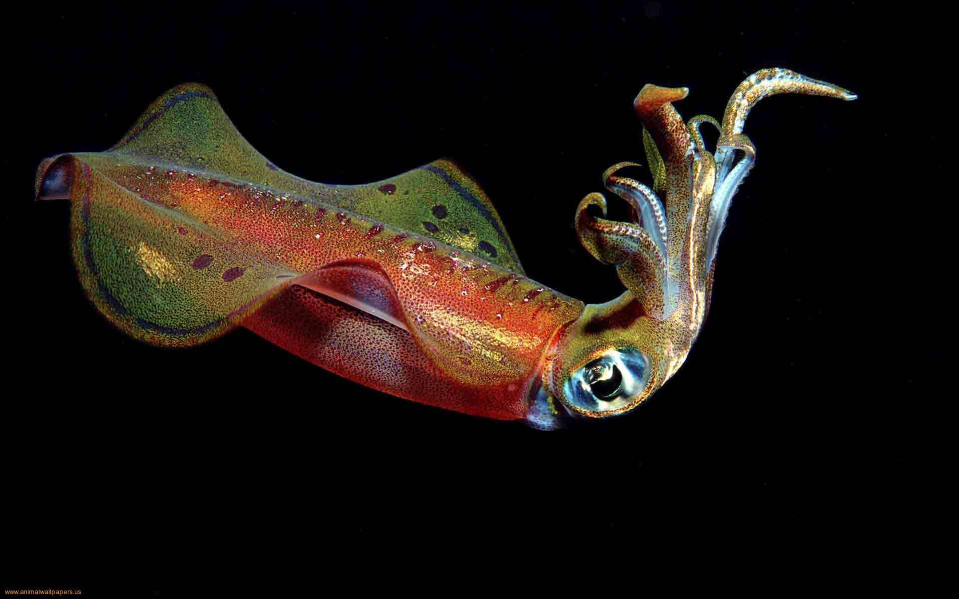
Our solution
Due to conditions of the competition the UAV will fly inside the station without any gravity force which is similar to the floating creature in the deep ocean. Our solution was the [Squid] .
Squid : depends on the buoyancy force which balance the its weight .

Slide 5
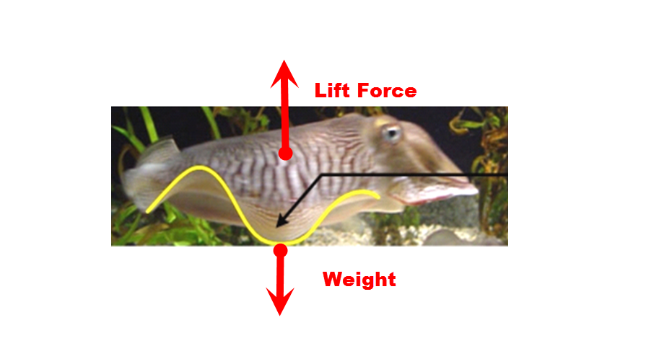
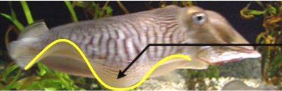
Our solution
Weightless

Slide 6
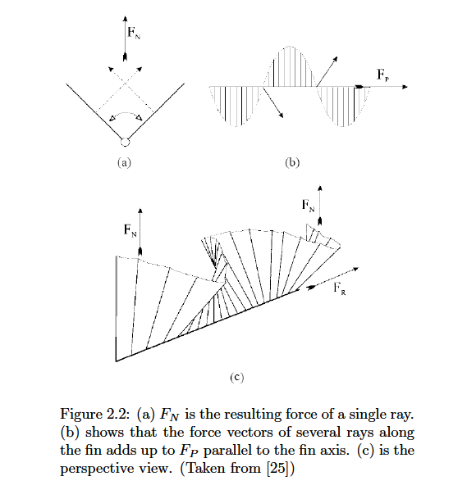
Thrust force
Undulating propulsion is our propulsion system which is used for move the drone and maneuver it .

Slide 7
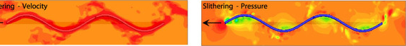
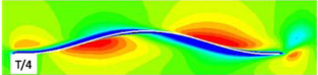
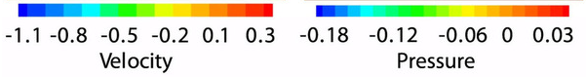
How to produce thrust .
From the CFD analysis for Undulating Propulsion for a real creatures we see The higher speed in red after every body element. The sum of them produce thrust like The case of jet engine which produce the thrust by the difference between input speed and the output speed of the engine

Slide 8
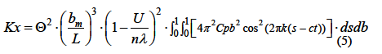
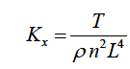
Equation of thrust

Slide 9
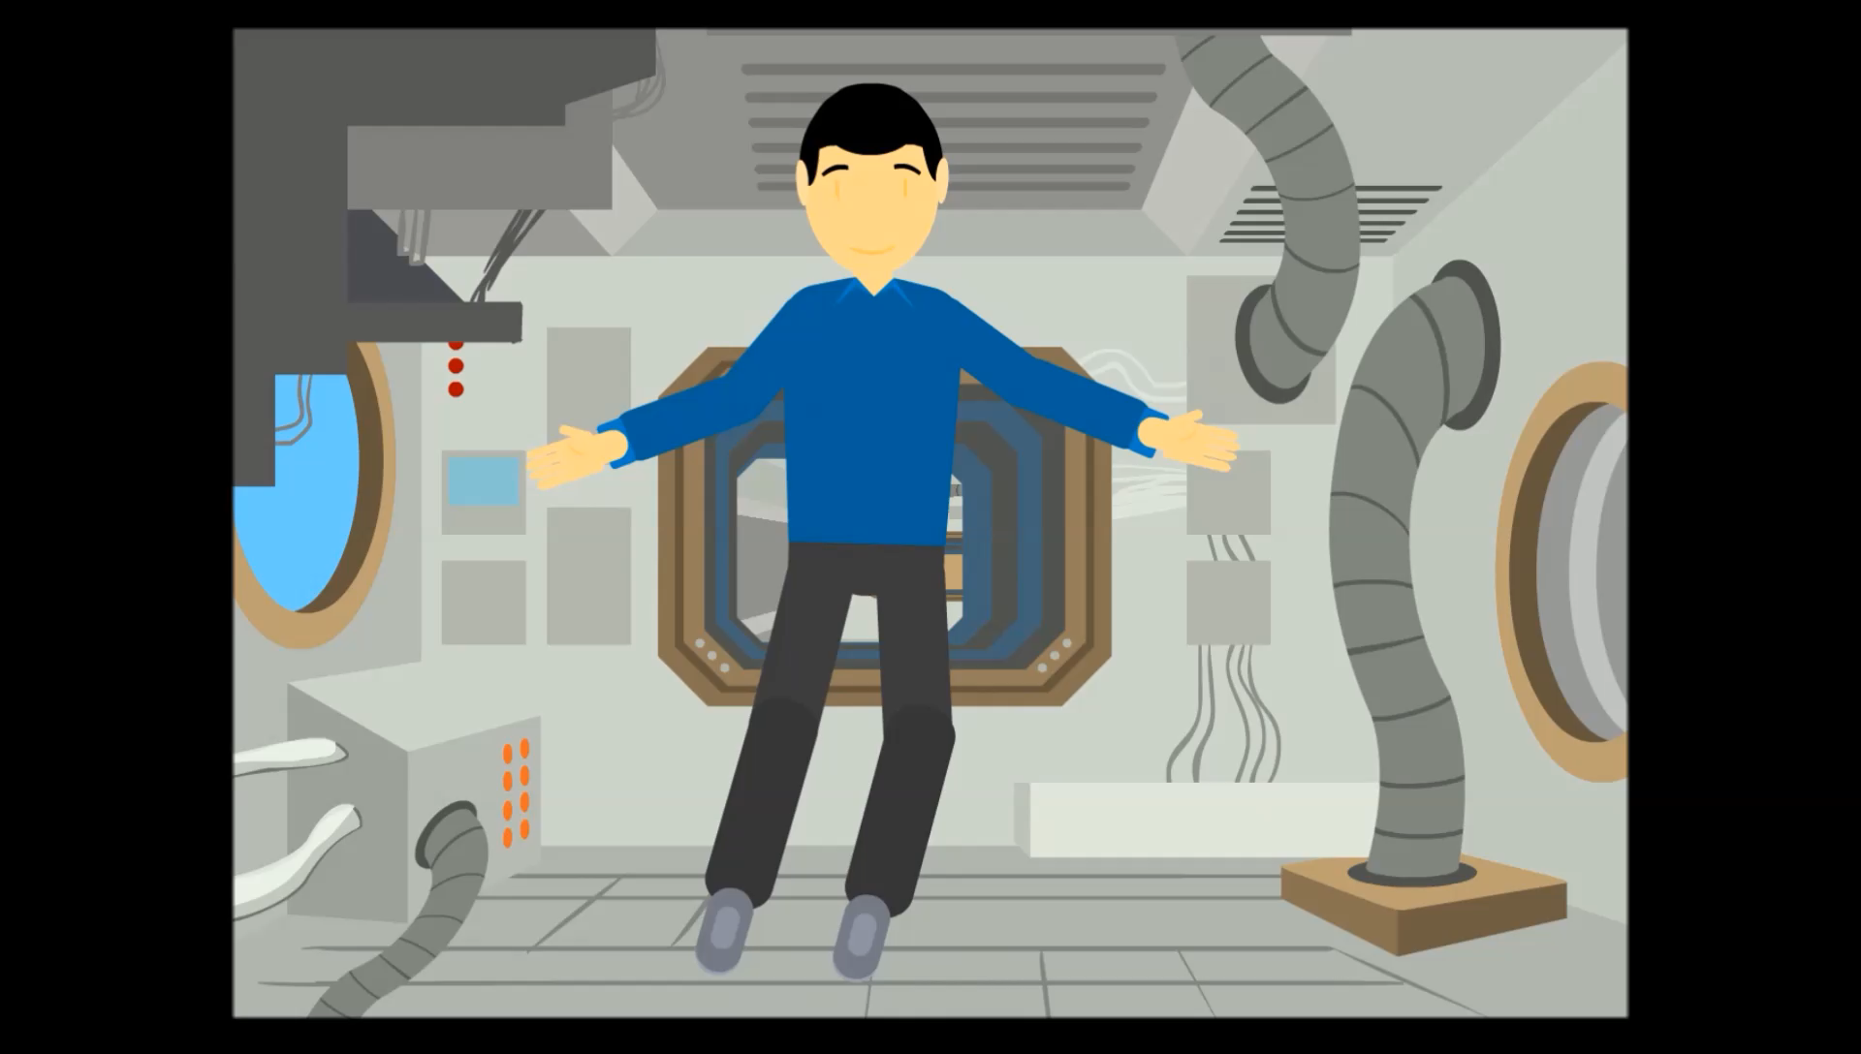

Slide 10
space Squid
1- Estimated dimension
mass = 5 kg
Length = 60 cm
Fuselage diameter = 20 cm
Fin length = 20 cm (maximum)
Speed = 4 m/s

Slide 11
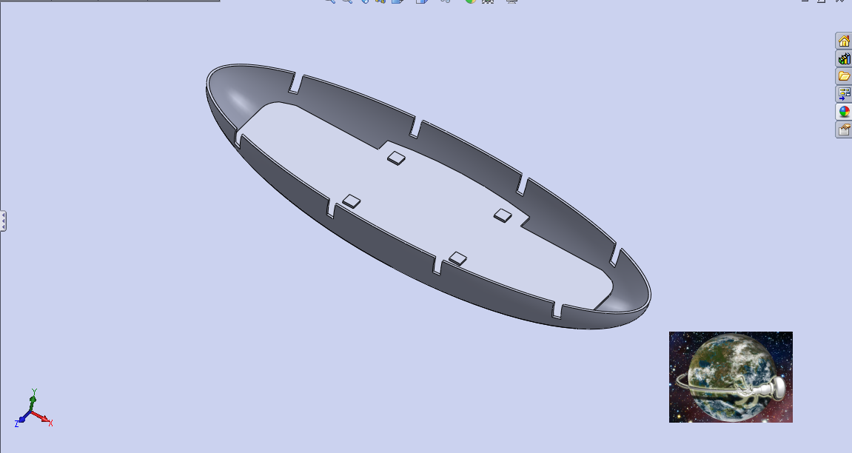
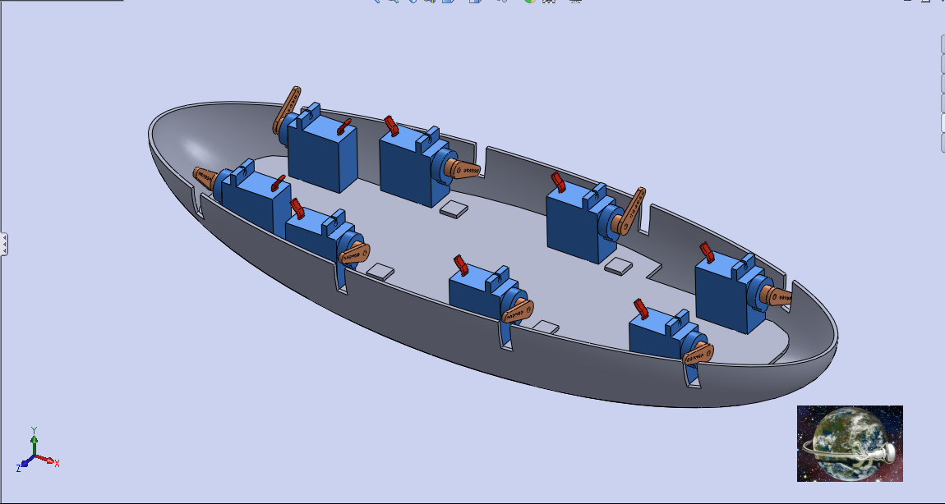
Simulation Work

Slide 12
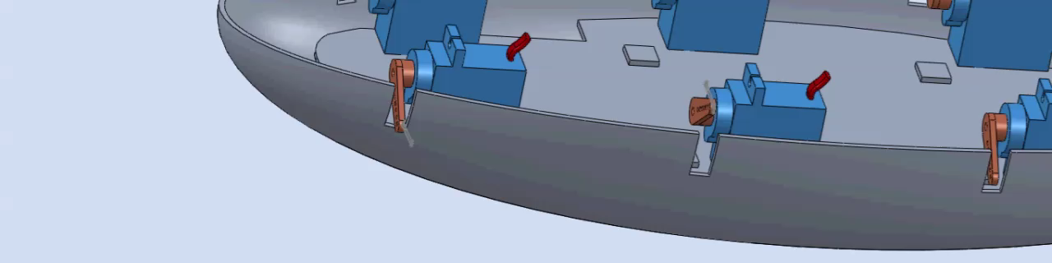
All Body Simulation

Slide 13
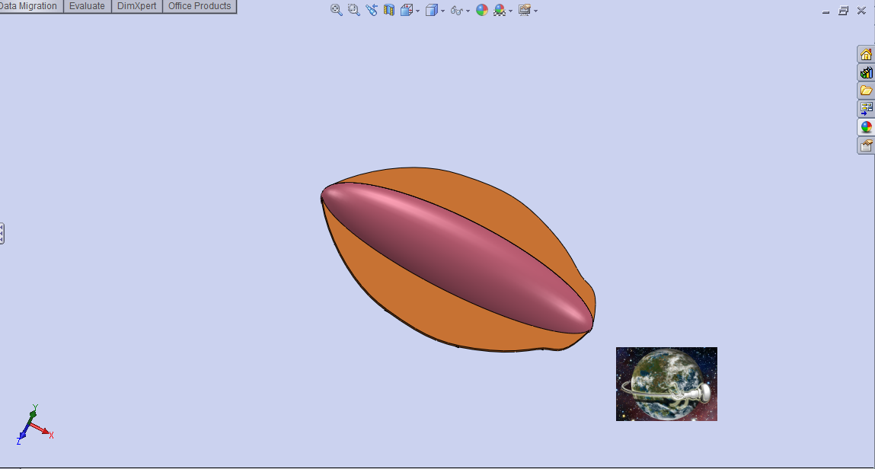
Last Imagination

Slide 14
Available positioning systems
ultrasonic sensor , gyro and accelerometer
Positioned system by cams in the station

Slide 15
Advantages of our design
Such a propulsion system is more energy efficient.
Less noisy than propellers.
Could fly in narrow areas .
Small size for the same pay load.
Safe (waves don’t required high frequency )
Autonomous
The lowest drag configuration

Slide 16
The future
One day , man will live at space … and when this happens we should be ready with outstanding UAVs that helps us beside the robots , It's just the beginning.
We just need your support and encourage to take our innovation into the space station.

